Slide 1

Exam AZ-305: Designing Azure Infrastructure Solutions Crash Course
Tim Warner

Slide 2
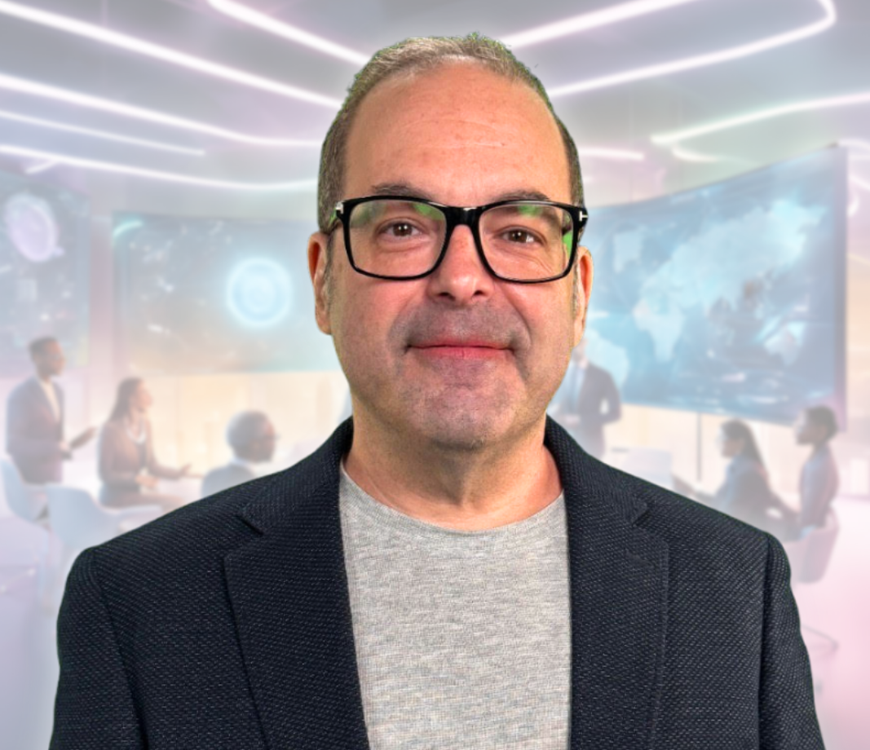
Tim Warner
Based in Nashville, TN, US
28-year Microsoft Certified Trainer (MCT)
6-year Microsoft MVP in Azure AI
Contact: TechTrainerTim.com

Slide 3
Agenda
Cover the exam objectives in themes
The exam is theoretical, not practical
That's why you suffered through AZ-104 ;)
We'll get our hands plenty dirty
Which benefits those learners who haven't yet had the pleasure of meeting AZ-104

Slide 4
Break Schedule (Central Time)
11:00 am - Start Segment 1 (Identity & Security)
12:00 pm - 9-min break - Start Segment 2 (Data Platform)
01:00 pm - 9-min Break - Start Segment 3 (Infrastructure Patterns)
02:00 pm - 9-min Break - Start Segment 4 (Networking)
03:00 pm - 9-min Break - Start Segment 5 (BCDR & Governance)
04:00 pm - Finish

Slide 5
Course Materials
timw.info/az305

Slide 6
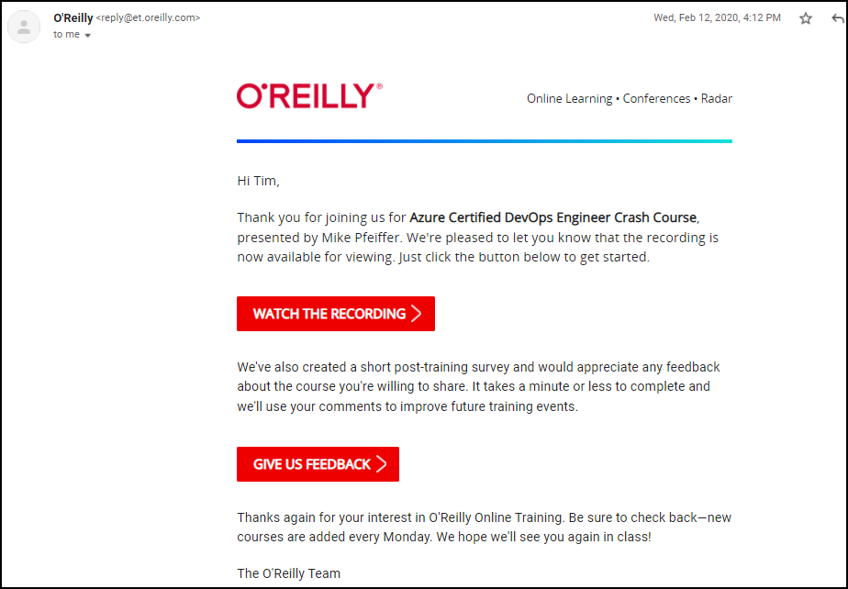
Session Recordings

Slide 7

Session Recordings

Slide 8

Session Recordings

Slide 9

Session Recordings

Slide 10


Mobile Browser: learning.oreilly.com

Slide 11



O'Reilly Mobile App

Slide 12
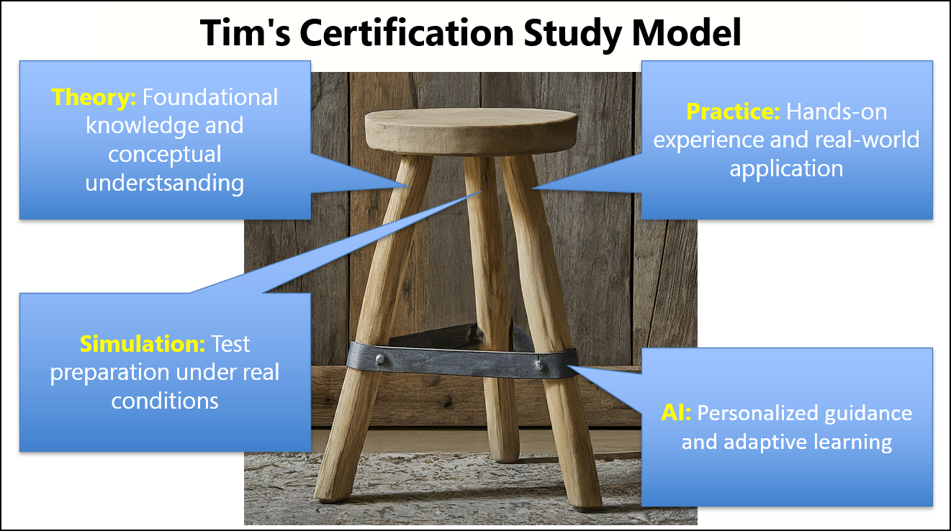

Slide 13
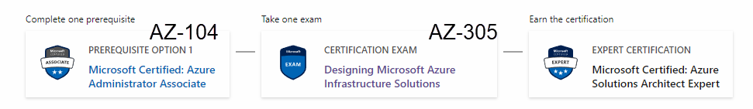
Azure Solutions Architect Expert
One-year validity

Slide 14
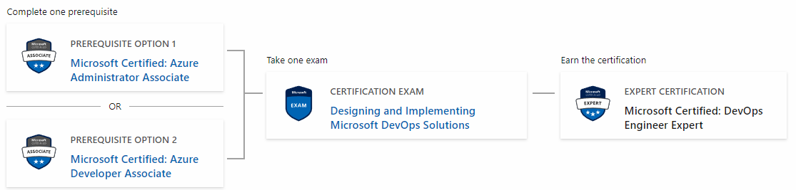
Microsoft DevOps Engineer Expert
AZ-104
AZ-400
AZ-204

Slide 15
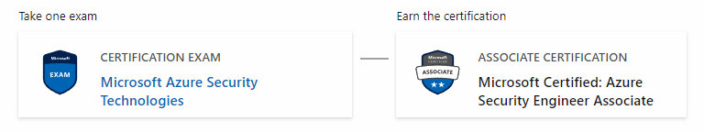
Azure Security Engineer
AZ-500

Slide 16
Critical Microsoft Docs Sites
Cloud Adoption Framework (CAF)
Well-Architected Framework (WAF)
Azure Architecture Center (AAC)

Slide 17
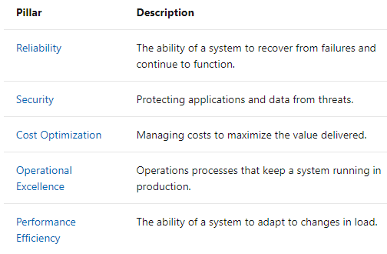
Microsoft Well-Architected Framework

Slide 18
Thank you!
Course materials: timw.info/az305
Contact: TechTrainerTim.com

Slide 19

Azure Monitor

Slide 20

Log Analytics

Slide 21

Sentinel

Slide 22
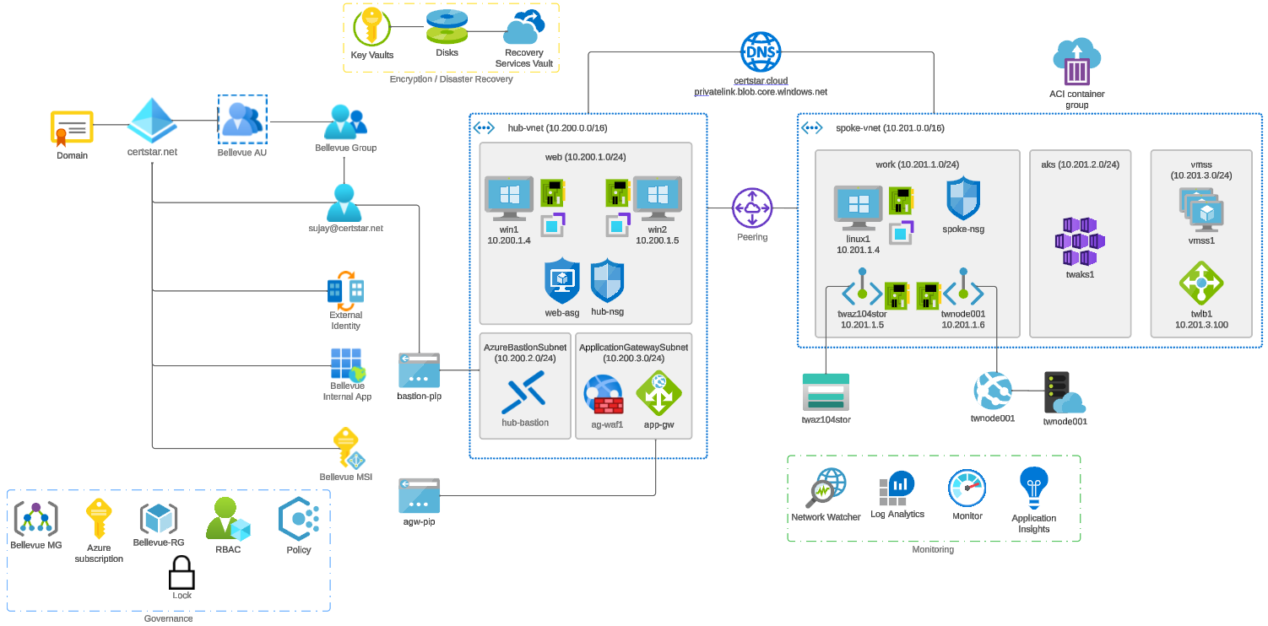


Slide 23

Tenant vs. Subscription

Slide 24

Hybrid Identity

Slide 25

Azure AD B2C

Slide 26
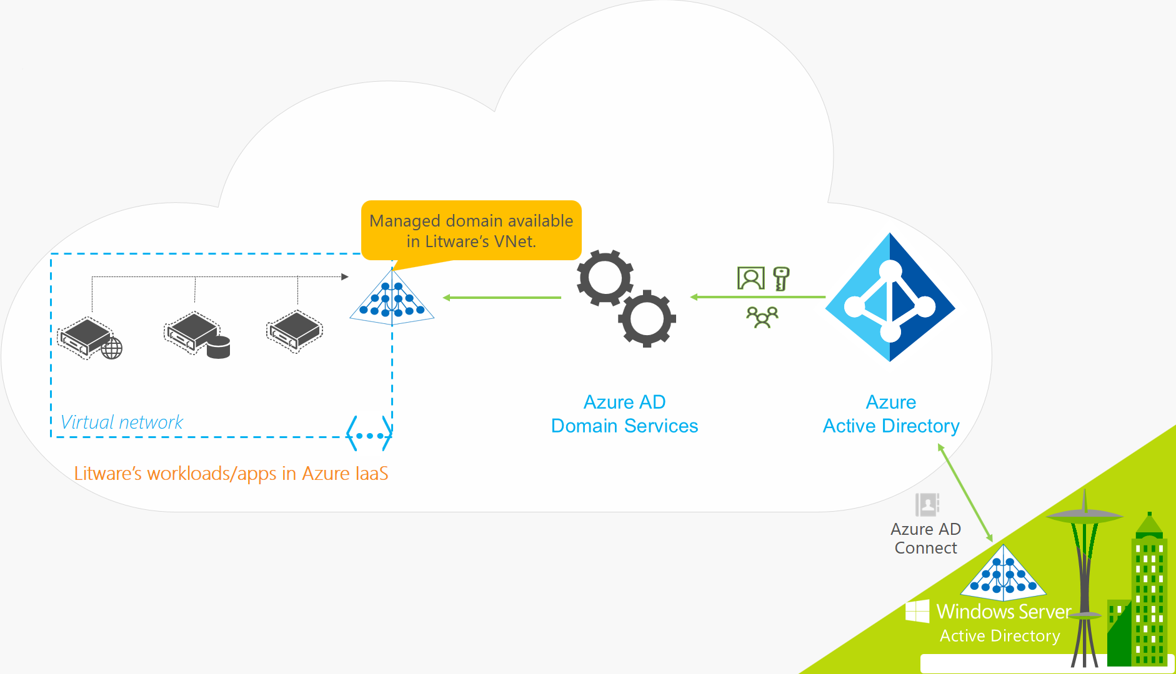
Azure AD Domain Services

Slide 27

Pass-through Authentication

Slide 28

Seamless Single Sign-on

Slide 29

Azure Management Scopes
/ Tenant Root

Slide 30
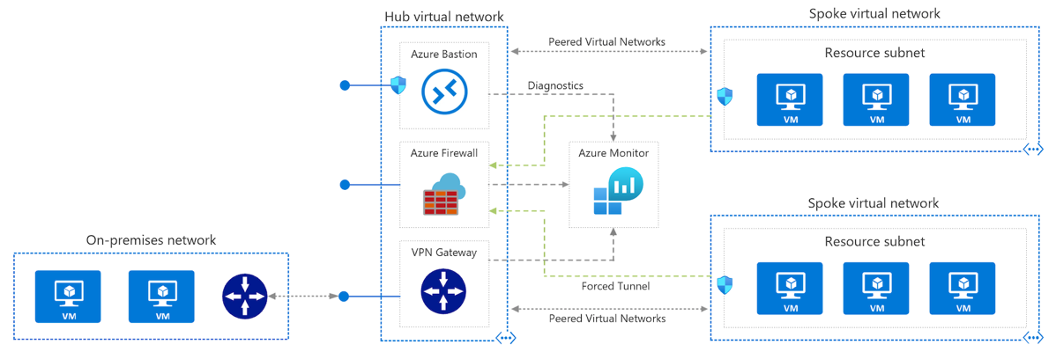
Azure VNet Hub-Spoke

Slide 31
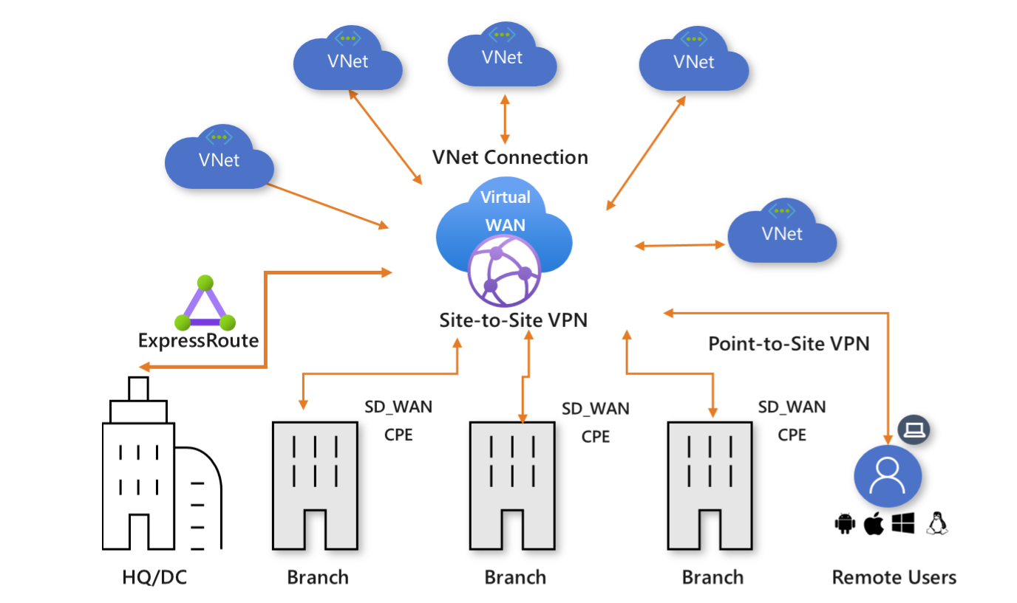
Azure Virtual WAN

Slide 32
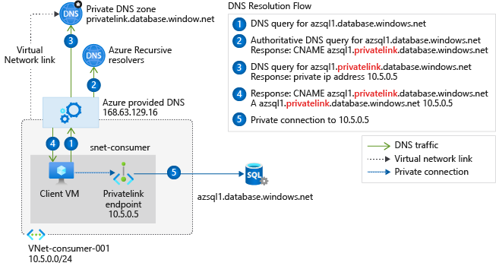
Private Link DNS Configuration

Slide 33

Azure Backup

Slide 34
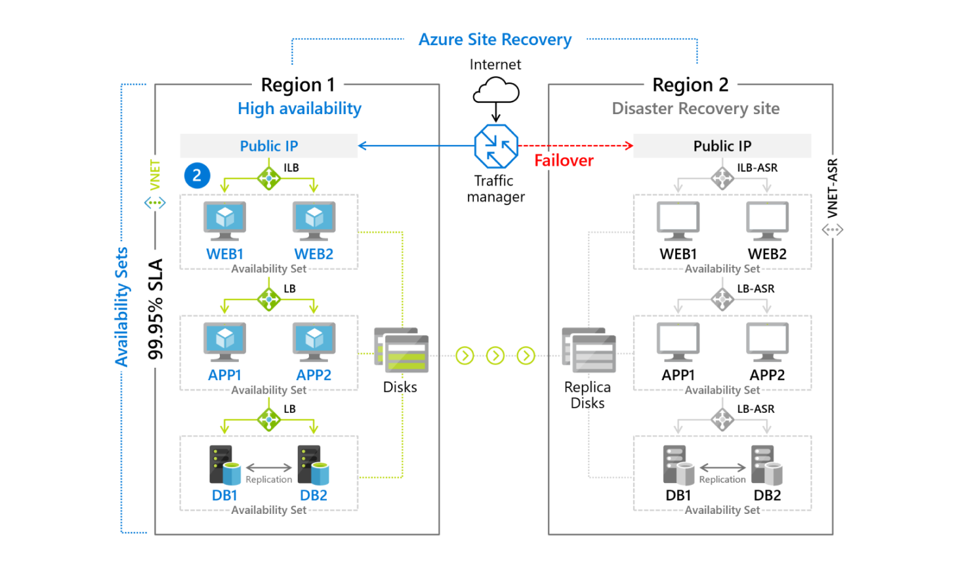
Azure Site Recovery

Slide 35

VM Scale Sets

Slide 36
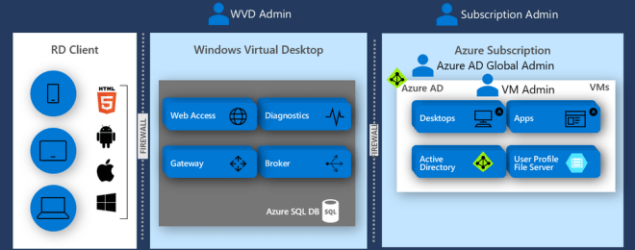
Windows Virtual Desktop (WVD)
timw.info/travis

Slide 37

Availability Set

Slide 38

Availability Zone

Slide 39

VM Networking

Slide 40

Load Balancing

Slide 41

VNet Peering

Slide 42

Hybrid Networking

Slide 43

Network Virtual Appliance

Slide 44

Azure Load Balancer

Slide 45

Application Gateway

Slide 46

Traffic Manager

Slide 47

Front Door Service

Slide 48


Docker Container Lifecycle
https://timw.info/3635f

Slide 49
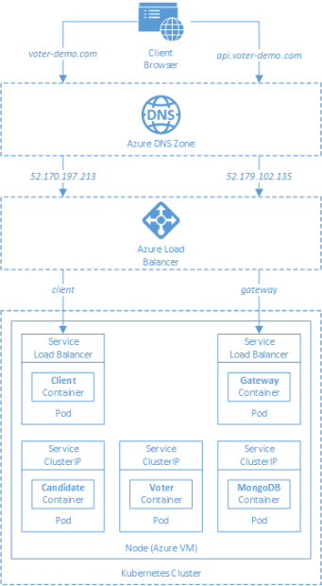
AKS

Slide 50
Azure Backup

Slide 51

Azure Site Recovery

Slide 52
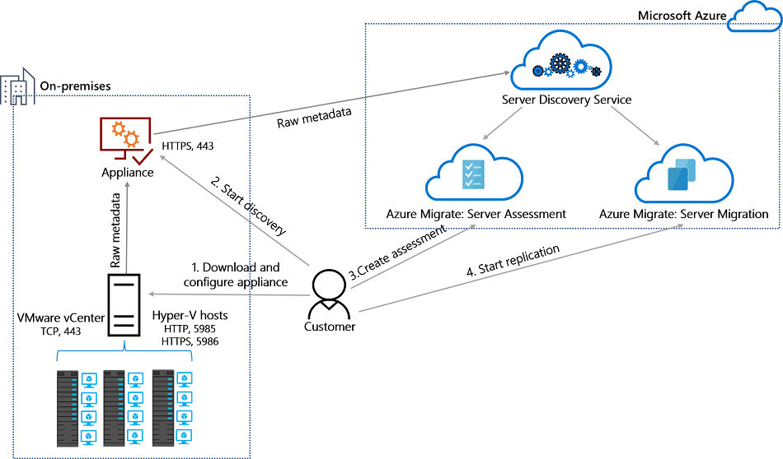
Azure Migrate

Slide 53
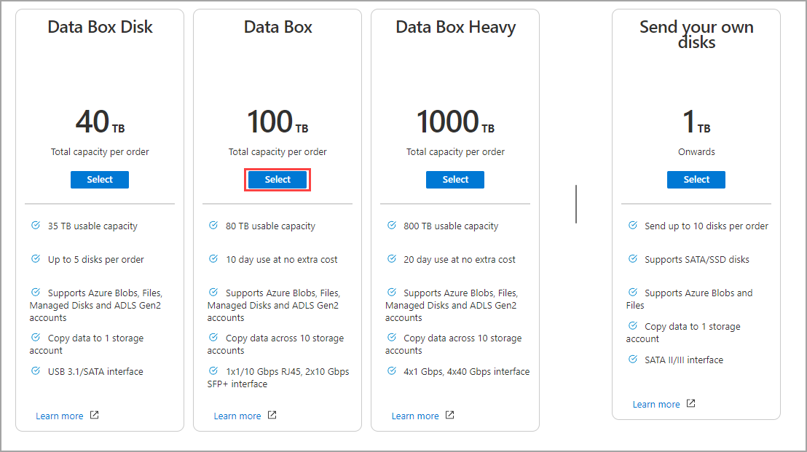
Azure Data Box

Slide 54

Data Pipelines

Slide 55
Storage Account Replication
1
3
3
2
LRS
ZRS

Slide 56
Storage Account Replication
3
3
GRS/RA-GRS

Slide 57
Storage Account Replication
1
3
1
3
2
2
GZRS – RA/GZRS

Slide 58

Always Encrypted

Slide 59
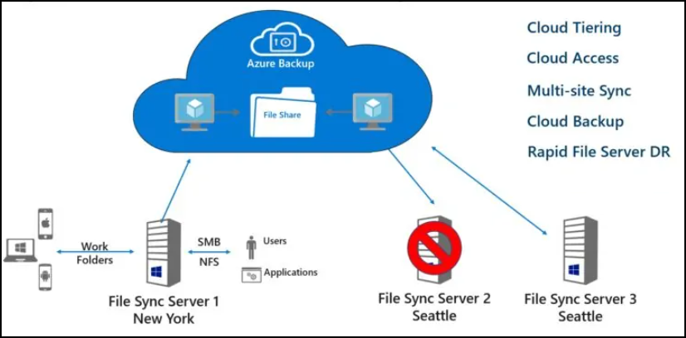
Azure File Sync

Slide 60
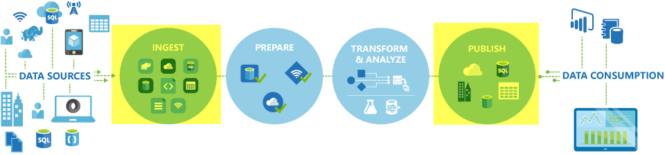
Azure Data Factory

Slide 61

Event Architecture

Slide 62

Event Architecture

Slide 63
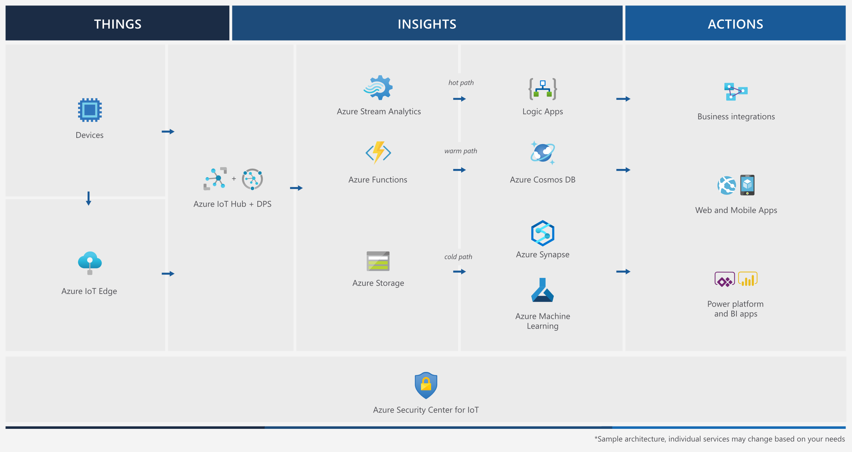
Event Architecture

Slide 64
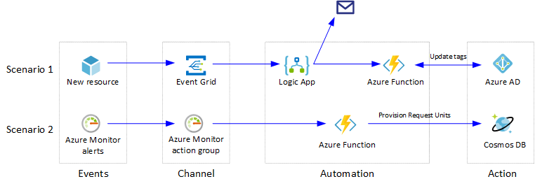
Event Architecture

Slide 65
Exam AZ-304 Item Types

Slide 66

Multiple Choice

Slide 67
Repeated Scenario
You need to move an Azure VM to another hardware host.
Solution: You redeploy the VM.
Does this solution meet the goal?
Yes
No

Slide 68

Select and Place

Slide 69

Build List and Reorder

Slide 70

Active Screen/Fill in the Blank

Slide 71

Case Study

Slide 72






Performance-Based Lab

Slide 73
Microsoft Online Testing

Slide 74
Microsoft Online Testing Process
timw.info/online

Slide 75

Microsoft Online Testing Process

Slide 76

Microsoft Online Testing Process

Slide 77

Microsoft Online Testing Process

Slide 78

Microsoft Online Testing Process

Slide 79

Microsoft Online Testing Process

Slide 80

Microsoft Online Testing Process

Slide 81

Microsoft Online Testing Process

Slide 82

Assemble the Required Materials
Webcam, microphone, and speakers
No headset
Wired or Wi-Fi Internet connection
No VPN
No tethering
Supported OS
Windows, macOS
Smartphone and ID
Mouse-based monitor
No touchscreen

Slide 83
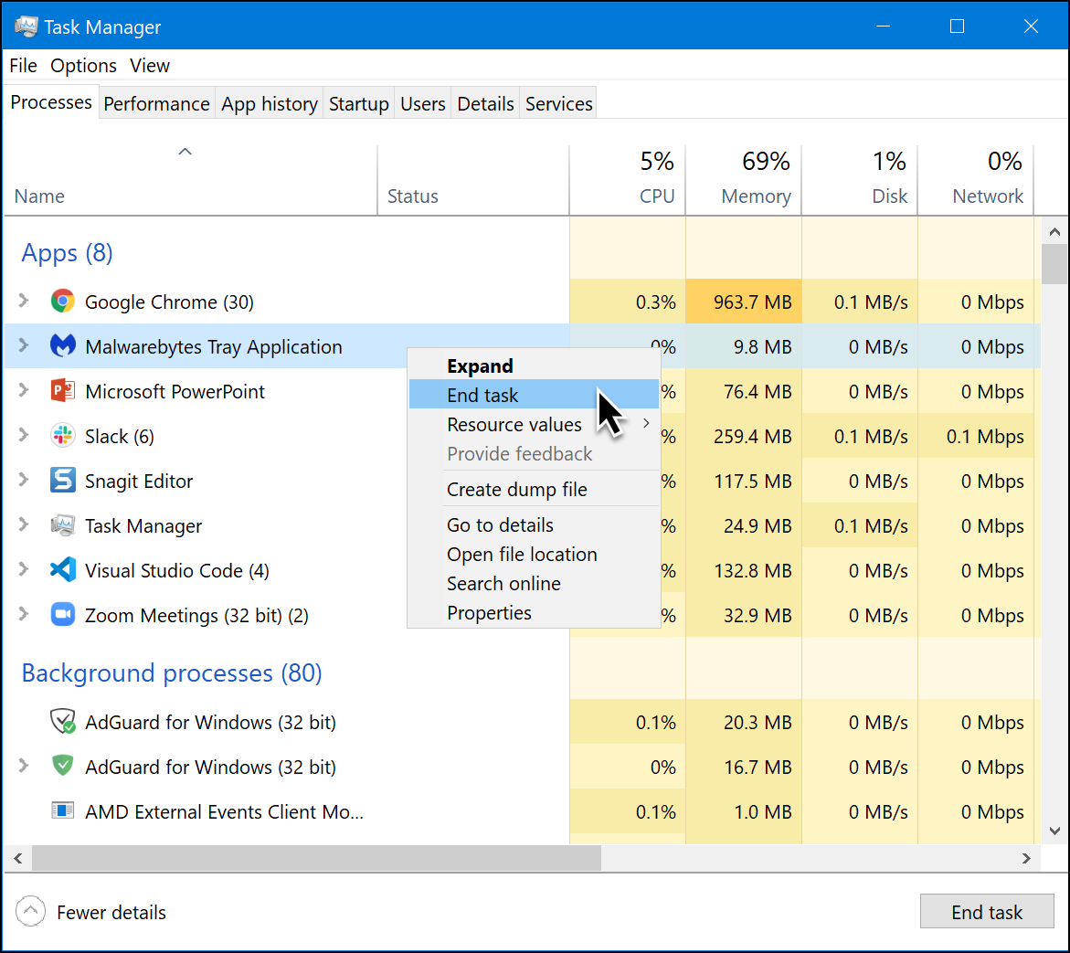
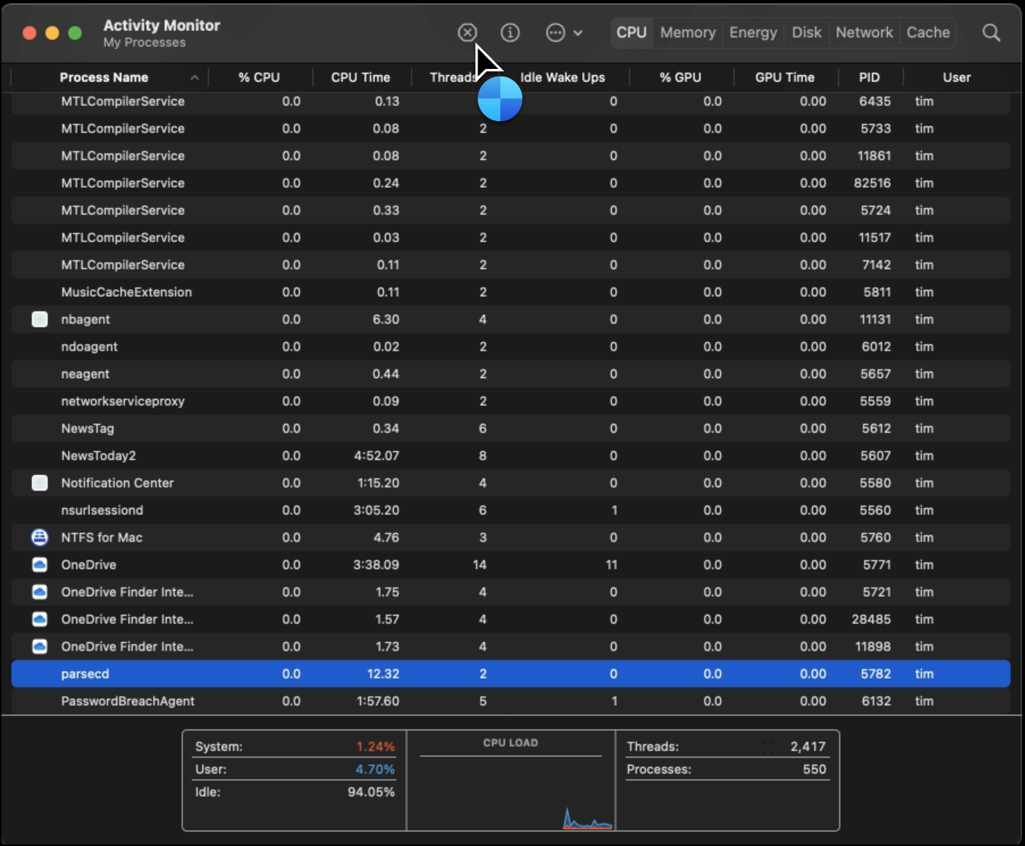
Prepare Your Testing Workstation
Windows
macOS

Slide 84
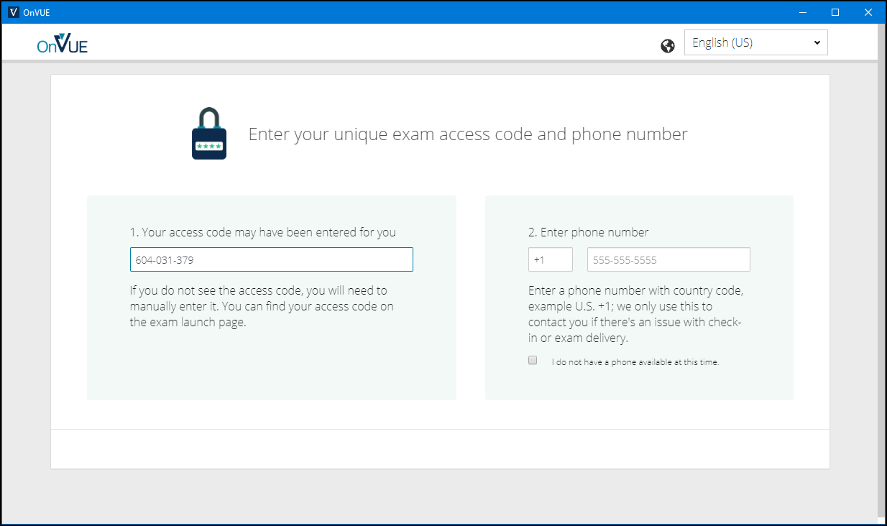
Pearson OnVUE Check-In

Slide 85
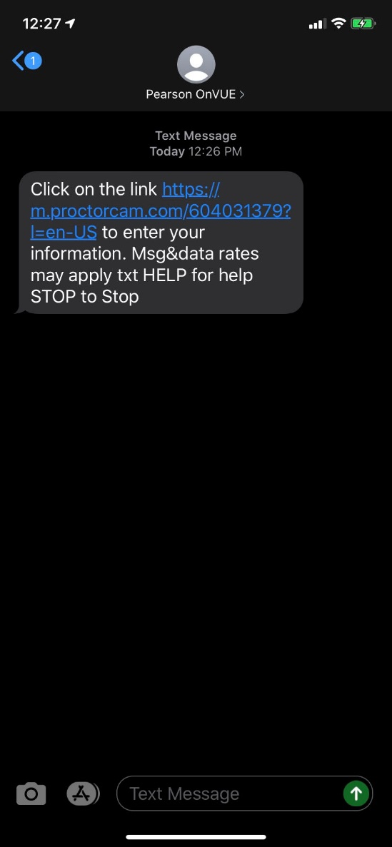
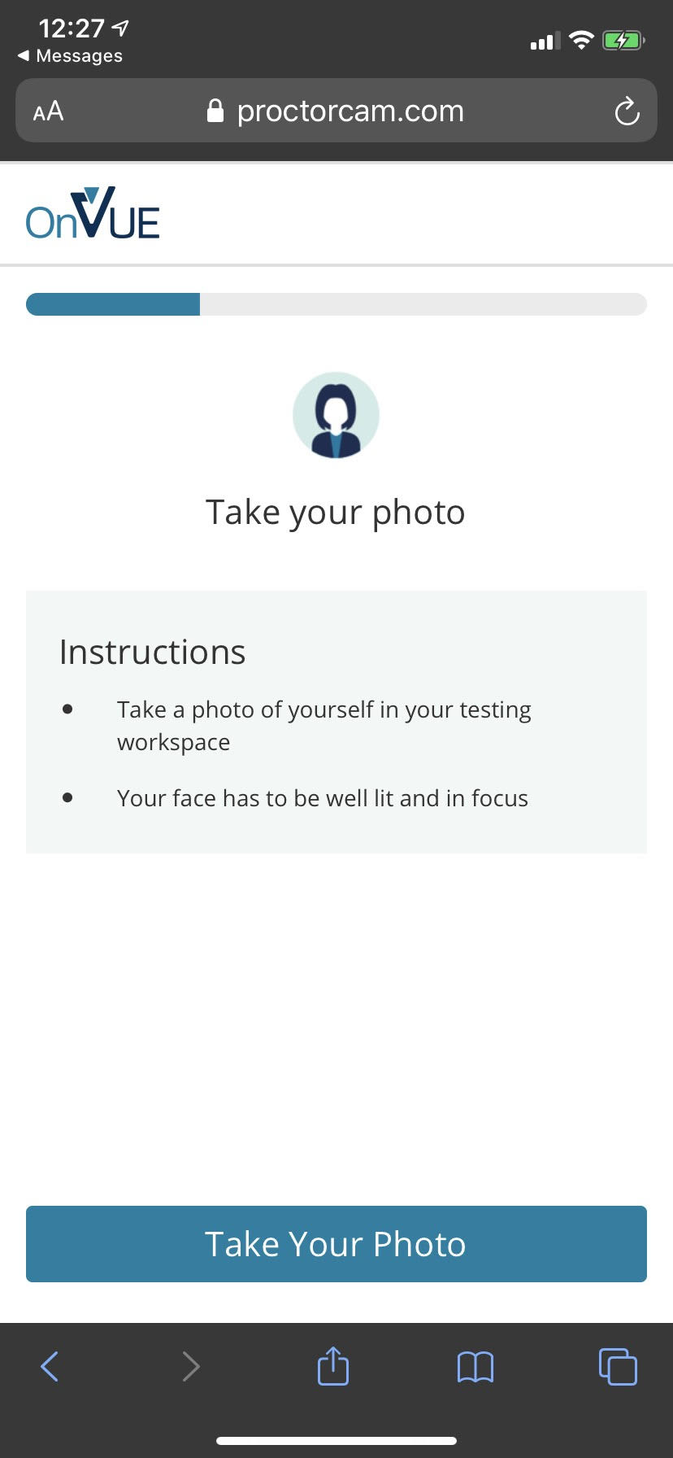
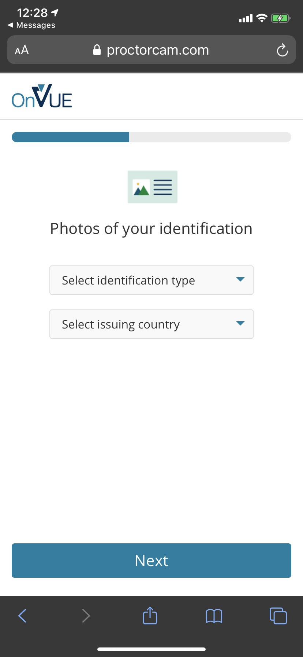
Pearson OnVUE Check-In

Slide 86
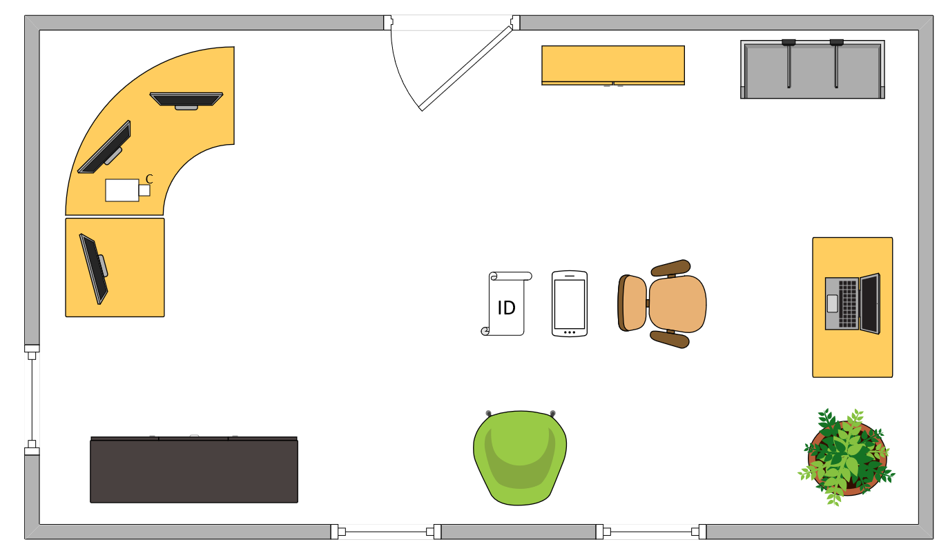
Tim’s Ideal Testing Room
No interruptions or bio breaks
Cover monitors and cameras
Pull back for environment photos
Clear table with laptop

Slide 87
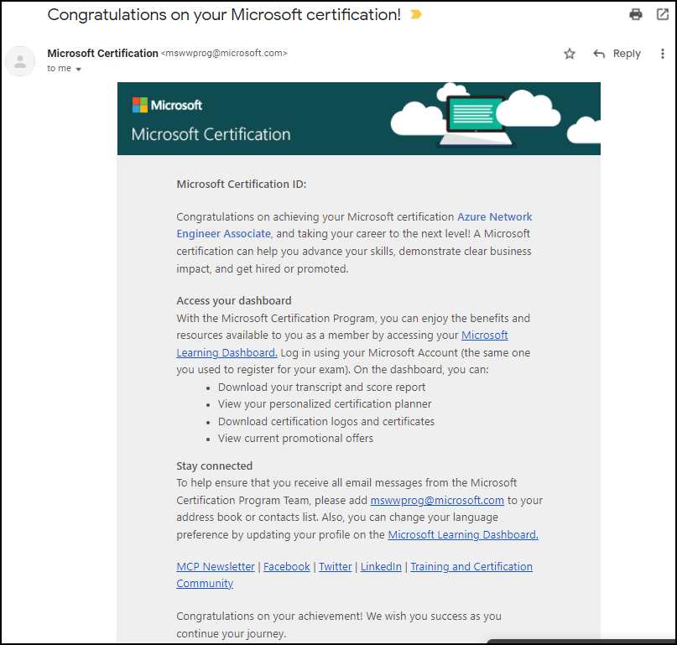
Congratulations!

Slide 88
AZ-305 Exam Strategy
Focus your skills accordingly:
60 percent Azure portal
20 percent Azure PowerShell
10 percent Azure CLI
10 percent KQL
Expect performance-based labs, but be thankful if you don't see 'em

